Slide 1
W4111 – Introduction to Databases Section 002, Spring 2024 Lecture 5: ER, Relational, SQL (IV)
© Donald F. Ferguson, 2024

Slide 2
W4111 – Introduction to Databases Section 002, Spring 2024 Lecture 5: ER, Relational, SQL (IV)
We will start in a couple of minutes.
© Donald F. Ferguson, 2024

Slide 3

Contents
3 | COMS W4111_002_2024_1: Lecture 5: ER, Relational, SQL (IV) © Donald F. Ferguson, 2024

Slide 4
Contents
Some Observations
ER (Diagram) Modeling – More Complex Scenarios
The Relational Model and Algebra Continued (Chapter 3) – Just Kidding
SQL Continued (Chapter 3, 4, 5)
Project Examples:
Web Applications and REST
Data Engineering and Visualization

Slide 5
Some Observations
5 | COMS W4111_002_2024_1: Lecture 5: ER, Relational, SQL (IV) © Donald F. Ferguson, 2024

Slide 6
Testing SQL and Relational

Slide 7
Database design, Entity-Relationship Model Some Complex Examples
7 | COMS W4111_002_2024_1: Lecture 5: ER, Relational, SQL (IV) © Donald F. Ferguson, 2024

Slide 8
Weak Entity Sets
Consider a section entity, which is uniquely identified by a course_id, semester, year, and sec_id.
Clearly, section entities are related to course entities. Suppose we create a relationship set sec_course between entity sets section and course.
Note that the information in sec_course is redundant, since section already has an attribute course_id, which identifies the course with which the section is related.
One option to deal with this redundancy is to get rid of the relationship sec_course; however, by doing so the relationship between section and course becomes implicit in an attribute, which is not desirable.

Slide 9
Weak Entity Sets (Cont.)
An alternative way to deal with this redundancy is to not store the attribute course_id in the section entity and to only store the remaining attributes section_id, year, and semester.
However, the entity set section then does not have enough attributes to identify a particular section entity uniquely
To deal with this problem, we treat the relationship sec_course as a special relationship that provides extra information, in this case, the course_id, required to identify section entities uniquely.
A weak entity set is one whose existence is dependent on another entity, called its identifying entity
Instead of associating a primary key with a weak entity, we use the identifying entity, along with extra attributes called discriminator to uniquely identify a weak entity.

Slide 10
Weak Entity Sets (Cont.)
An entity set that is not a weak entity set is termed a strong entity set.
Every weak entity must be associated with an identifying entity; that is, the weak entity set is said to be existence dependent on the identifying entity set.
The identifying entity set is said to own the weak entity set that it identifies.
The relationship associating the weak entity set with the identifying entity set is called the identifying relationship.
Note that the relational schema we eventually create from the entity set section does have the attribute course_id, for reasons that will become clear later, even though we have dropped the attribute course_id from the entity set section.

Slide 11
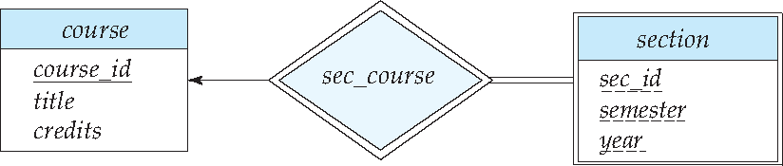
Expressing Weak Entity Sets
In E-R diagrams, a weak entity set is depicted via a double rectangle.
We underline the discriminator of a weak entity set with a dashed line.
The relationship set connecting the weak entity set to the identifying strong entity set is depicted by a double diamond.
Primary key for section – (course_id, sec_id, semester, year)

Slide 12
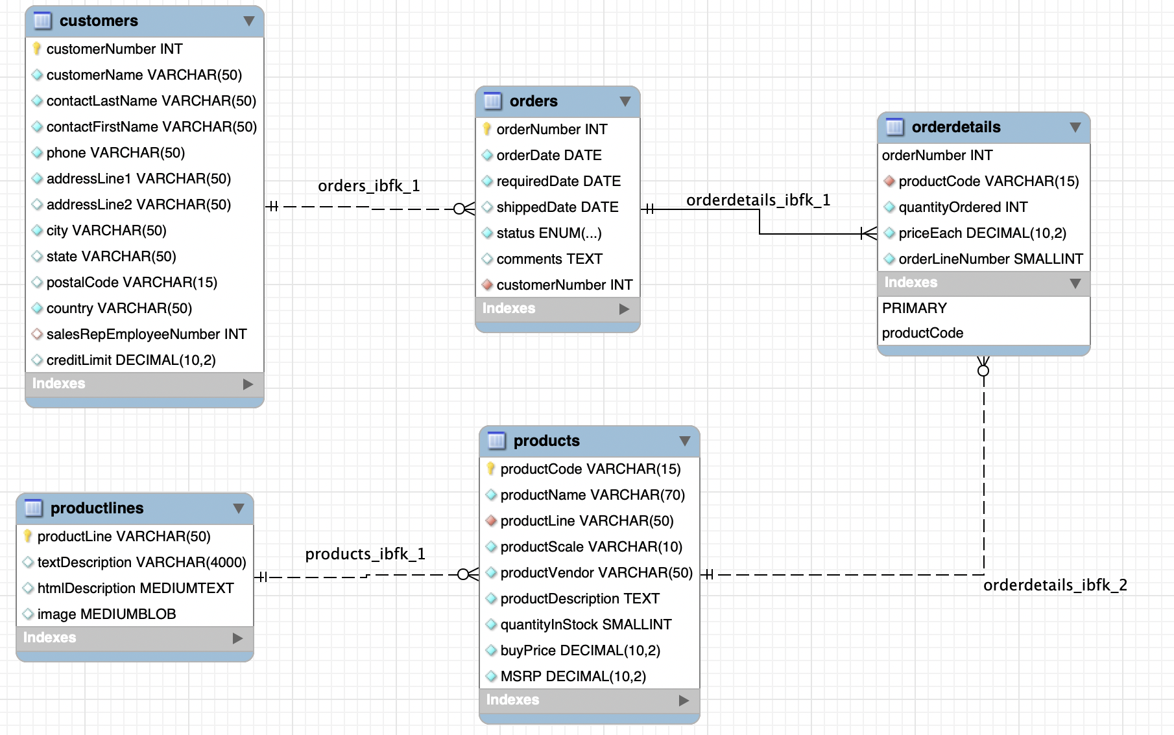
An Example – Classic Models
https://www.mysqltutorial.org/mysql-sample-database.aspx/

Slide 13
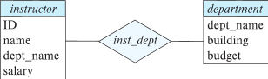
Redundant Attributes
Suppose we have entity sets:
instructor, with attributes: ID, name, dept_name, salary
department, with attributes: dept_name, building, budget
We model the fact that each instructor has an associated department using a relationship set inst_dept
The attribute dept_name in instructor replicates information present in the relationship and is therefore redundant
and needs to be removed.
BUT: when converting back to tables, in some cases the attribute gets reintroduced, as we will see later.

Slide 15
Design Alternatives
In designing a database schema, we must ensure that we avoid two major pitfalls:
Redundancy: a bad design may result in repeat information.
Redundant representation of information may lead to data inconsistency among the various copies of information
Incompleteness: a bad design may make certain aspects of the enterprise difficult or impossible to model.
Avoiding bad designs is not enough. There may be a large number of good designs from which we must choose.
Emphasis Added
Notes:
15

Slide 16
Relationship Sets (Cont.)
An attribute can also be associated with a relationship set.
For instance, the advisor relationship set between entity sets instructor and student may have the attribute date which tracks when the student started being associated with the advisor

Slide 17
Relationship Sets with Attributes

Slide 18
Roles
Entity sets of a relationship need not be distinct
Each occurrence of an entity set plays a “role” in the relationship
The labels “course_id” and “prereq_id” are called roles.

Slide 19
Aggregation
Consider the ternary relationship proj_guide, which we saw earlier
Suppose we want to record evaluations of a student by a guide on a project

Slide 20
Aggregation (Cont.)
Relationship sets eval_for and proj_guide represent overlapping information
Every eval_for relationship corresponds to a proj_guide relationship
However, some proj_guide relationships may not correspond to any eval_for relationships
So we can’t discard the proj_guide relationship
Eliminate this redundancy via aggregation
Treat relationship as an abstract entity
Allows relationships between relationships
Abstraction of relationship into new entity

Slide 21
Aggregation (Cont.)
Eliminate this redundancy via aggregation without introducing redundancy, the following diagram represents:
A student is guided by a particular instructor on a particular project
A student, instructor, project combination may have an associated evaluation
The simplest way to handle in relational is an associative entity.
Some thoughts here: https://www.geeksforgeeks.org/aggregate-data-model-in-nosql/
Notes:
21

Slide 22
Reduction to Relational Schemas
To represent aggregation, create a schema containing
Primary key of the aggregated relationship,
The primary key of the associated entity set
Any descriptive attributes
In our example:
The schema eval_for is:
eval_for (s_ID, project_id, i_ID, evaluation_id)
The schema proj_guide is redundant.

Slide 23
Specialization
Top-down design process; we designate sub-groupings within an entity set that are distinctive from other entities in the set.
These sub-groupings become lower-level entity sets that have attributes or participate in relationships that do not apply to the higher-level entity set.
Depicted by a triangle component labeled ISA (e.g., instructor “is a” person).
Attribute inheritance – a lower-level entity set inherits all the attributes and relationship participation of the higher-level entity set to which it is linked.

Slide 24
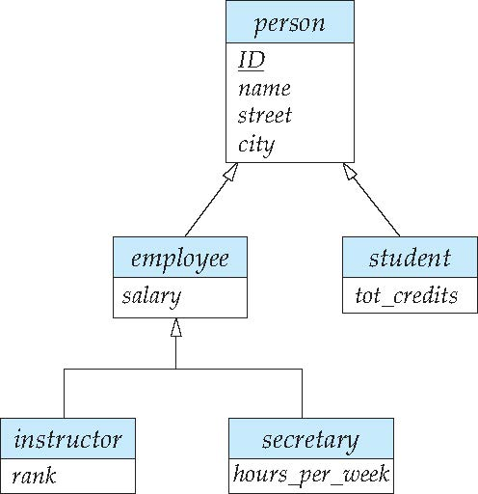
Specialization Example
Overlapping – employee and student
Disjoint – instructor and secretary
Total and partial

Slide 25
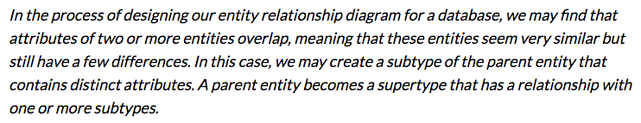
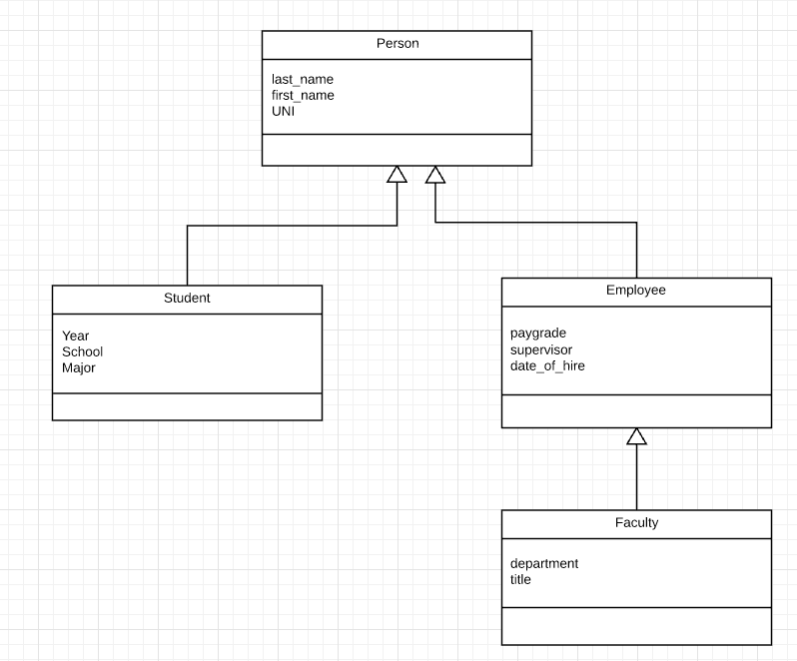
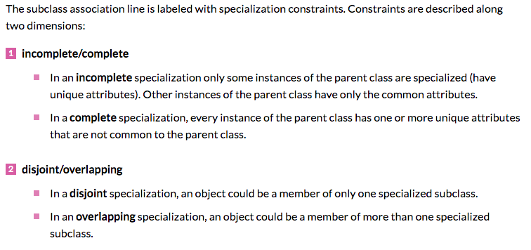
Inheritance/Specialization
Are all employees faculty?
Can students also be employees?
http://www.vertabelo.com/blog/technical-articles/inheritance-in-a-relational-database

Slide 26
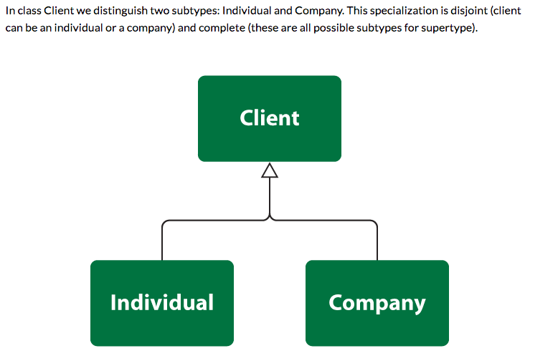
Specialization

Slide 27
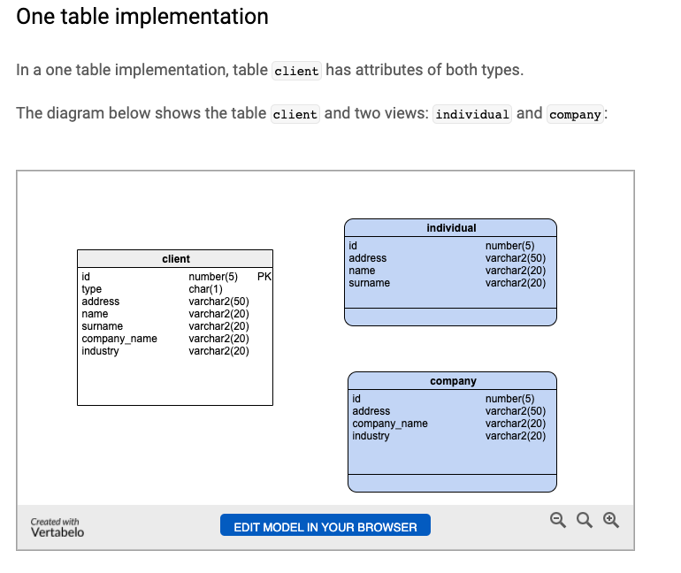
One Table
Views
Tables

Slide 28
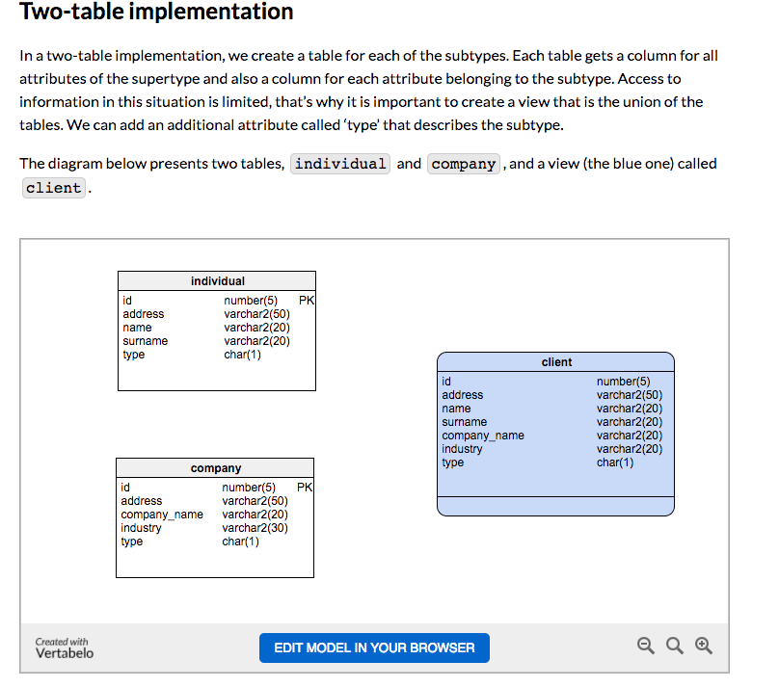
Two Table
View
Tables

Slide 29
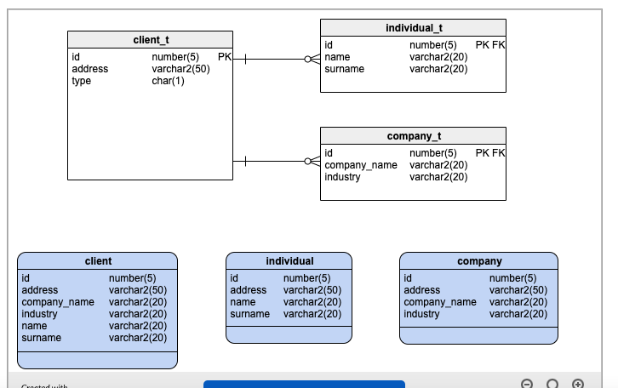
Three Table

Slide 30
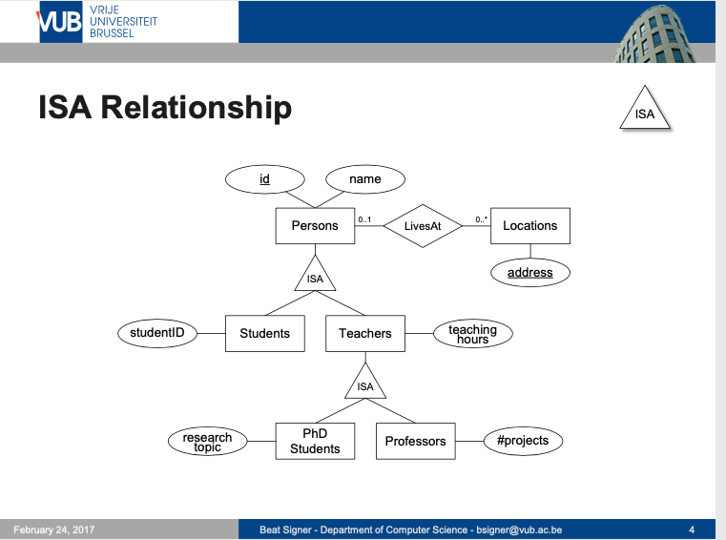
ISA Relationship

Slide 31
ER vs. UML Class Diagrams
ER Diagram Notation
Equivalent in UML
I use this approach in Crow’s Foot Notation but that is not standard.
* Generalization can use merged or separate arrows independent
of disjoint/overlapping

Slide 32
Relation Model and Algebra
32 | COMS W4111_002_2024_1: Lecture 5: ER, Relational, SQL (IV) © Donald F. Ferguson, 2024

Slide 33
Relation Model and Algebra
Just kidding! We are basically done with relational algebra!
33 | COMS W4111_002_2024_1: Lecture 5: ER, Relational, SQL (IV) © Donald F. Ferguson, 2024

Slide 34
SQL
34 | COMS W4111_002_2024_1: Lecture 5: ER, Relational, SQL (IV) © Donald F. Ferguson, 2024

Slide 35

Metadata
35 | COMS W4111_002_2024_1: Lecture 5: ER, Relational, SQL (IV) © Donald F. Ferguson, 2024

Slide 36
Codd’s 12 Rules
Rule 4: Active Online Catalog
The structure description of the entire database must be stored in an online catalog, known as data dictionary, which can be accessed by authorized users. Users can use the same query language to access the catalog which they use to access the database itself.
Rule 5: Comprehensive Data Sub-Language Rule
A database can only be accessed using a language having linear syntax that supports data definition, data manipulation, and transaction management operations. This language can be used directly or by means of some application. If the database allows access to data without any help of this language, then it is considered as a violation.
Rule 6: View Updating Rule
All the views of a database, which can theoretically be updated, must also be updatable by the system.
Rule 1: Information Rule
The data stored in a database, may it be user data or metadata, must be a value of some table cell. Everything in a database must be stored in a table format.
Rule 2: Guaranteed Access Rule
Every single data element (value) is guaranteed to be accessible logically with a combination of table-name, primary-key (row value), and attribute-name (column value). No other means, such as pointers, can be used to access data.
Rule 3: Systematic Treatment of NULL Values
The NULL values in a database must be given a systematic and uniform treatment. This is a very important rule because a NULL can be interpreted as one the following − data is missing, data is not known, or data is not applicable.

Slide 37
Codd’s 12 Rules
Rule 10: Integrity Independence
A database must be independent of the application that uses it. All its integrity constraints can be independently modified without the need of any change in the application. This rule makes a database independent of the front-end application and its interface.
Rule 11: Distribution Independence
The end-user must not be able to see that the data is distributed over various locations. Users should always get the impression that the data is located at one site only. This rule has been regarded as the foundation of distributed database systems.
Rule 12: Non-Subversion Rule
If a system has an interface that provides access to low-level records, then the interface must not be able to subvert the system and bypass security and integrity constraints.
Rule 7: High-Level Insert, Update, and Delete Rule
A database must support high-level insertion, updation, and deletion. This must not be limited to a single row, that is, it must also support union, intersection and minus operations to yield sets of data records.
Rule 8: Physical Data Independence
The data stored in a database must be independent of the applications that access the database. Any change in the physical structure of a database must not have any impact on how the data is being accessed by external applications.
Rule 9: Logical Data Independence
The logical data in a database must be independent of its user’s view (application). Any change in logical data must not affect the applications using it. For example, if two tables are merged or one is split into two different tables, there should be no impact or change on the user application. This is one of the most difficult rule to apply.

Slide 38
Metadata and Catalog
‘Metadata is "data that provides information about other data". In other words, it is "data about data". Many distinct types of metadata exist, including descriptive metadata, structural metadata, administrative metadata, reference metadata and statistical metadata.’ (https://en.wikipedia.org/wiki/Metadata)
“The database catalog of a database instance consists of metadata in which definitions of database objects such as base tables, views (virtual tables), synonyms, value ranges, indexes, users, and user groups are stored. ... ... The SQL standard specifies a uniform means to access the catalog, called the INFORMATION_SCHEMA, but not all databases follow this ...” (https://en.wikipedia.org/wiki/Database_catalog)
Codd’s Rule 4: Dynamic online catalog based on the relational model:
The data base description is represented at the logical level in the same way as ordinary data, so that authorized users can apply the same relational language to its interrogation as they apply to the regular data.

Slide 39
Data Definition Language (DDL)
Specification notation for defining the database schema
Example: create table instructor ( ID char(5), name varchar(20), dept_name varchar(20), salary numeric(8,2))
DDL compiler generates a set of table templates stored in a data dictionary
Data dictionary contains metadata (i.e., data about data)
Database schema
Integrity constraints
Primary key (ID uniquely identifies instructors)
Authorization
Who can access what
Notes:
39

Slide 40
Data Dictionary Storage
The Data dictionary (also called system catalog) stores metadata; that is, data about data, such as
Information about relations
names of relations
names, types and lengths of attributes of each relation
names and definitions of views
integrity constraints
User and accounting information, including passwords
Statistical and descriptive data
number of tuples in each relation
Physical file organization information
How relation is stored (sequential/hash/…)
Physical location of relation
Information about indices (Chapter 14)

Slide 41
Relational Representation of System Metadata
Relational representation on disk
Specialized data structures designed for efficient access, in memory

Slide 42
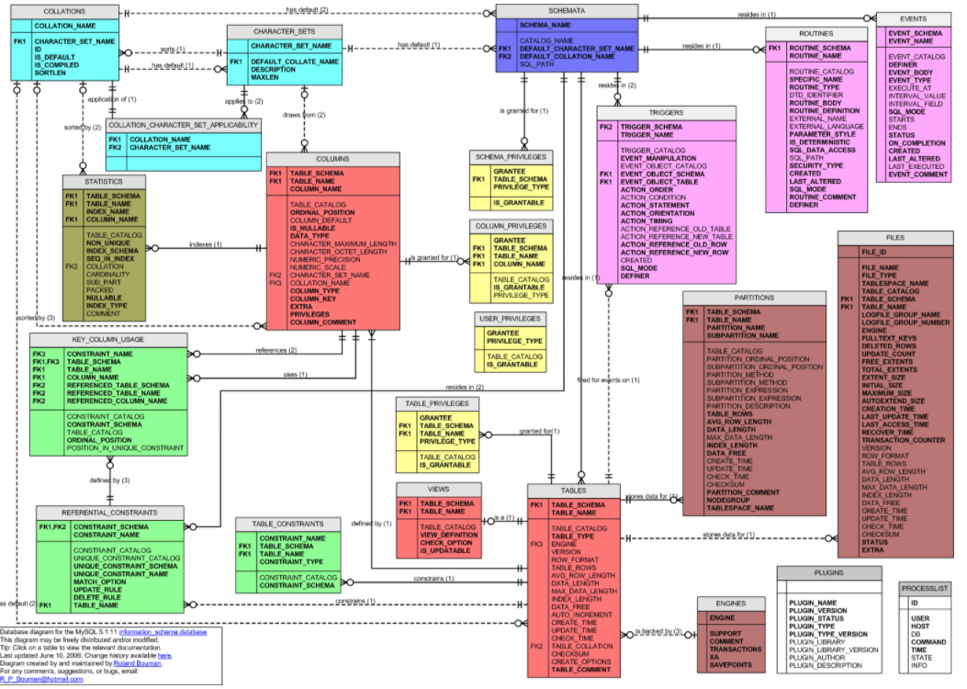
MySQL Catalog (Information_Schema)
Some of the MySQL Information Schema Tables:
'ADMINISTRABLE_ROLE_AUTHORIZATIONS'
'APPLICABLE_ROLES'
'CHARACTER_SETS'
'CHECK_CONSTRAINTS'
'COLUMN_PRIVILEGES'
'COLUMN_STATISTICS'
'COLUMNS'
'ENABLED_ROLES'
'ENGINES'
'EVENTS'
'FILES'
'KEY_COLUMN_USAGE'
'PARAMETERS'
'REFERENTIAL_CONSTRAINTS'
'RESOURCE_GROUPS'
'ROLE_COLUMN_GRANTS'
'ROLE_ROUTINE_GRANTS'
'ROLE_TABLE_GRANTS'
'ROUTINES'
'SCHEMA_PRIVILEGES'
'STATISTICS'
'TABLE_CONSTRAINTS'
'TABLE_PRIVILEGES'
'TABLES'
'TABLESPACES'
'TRIGGERS'
'USER_PRIVILEGES'
'VIEW_ROUTINE_USAGE'
'VIEW_TABLE_USAGE'
'VIEWS'
CREATE and ALTER statements modify the data.
DBMS reads information:
Parsing
Optimizer
etc.

Slide 43
Metadata
Notebook examples.

Slide 44
Some Types and Functions
44 | COMS W4111_002_2024_1: Lecture 5: ER, Relational, SQL (IV) © Donald F. Ferguson, 2024

Slide 45
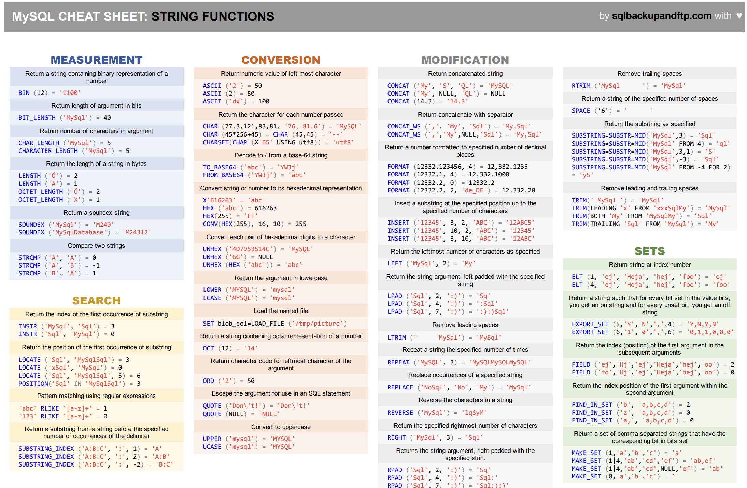
Functions

Slide 46
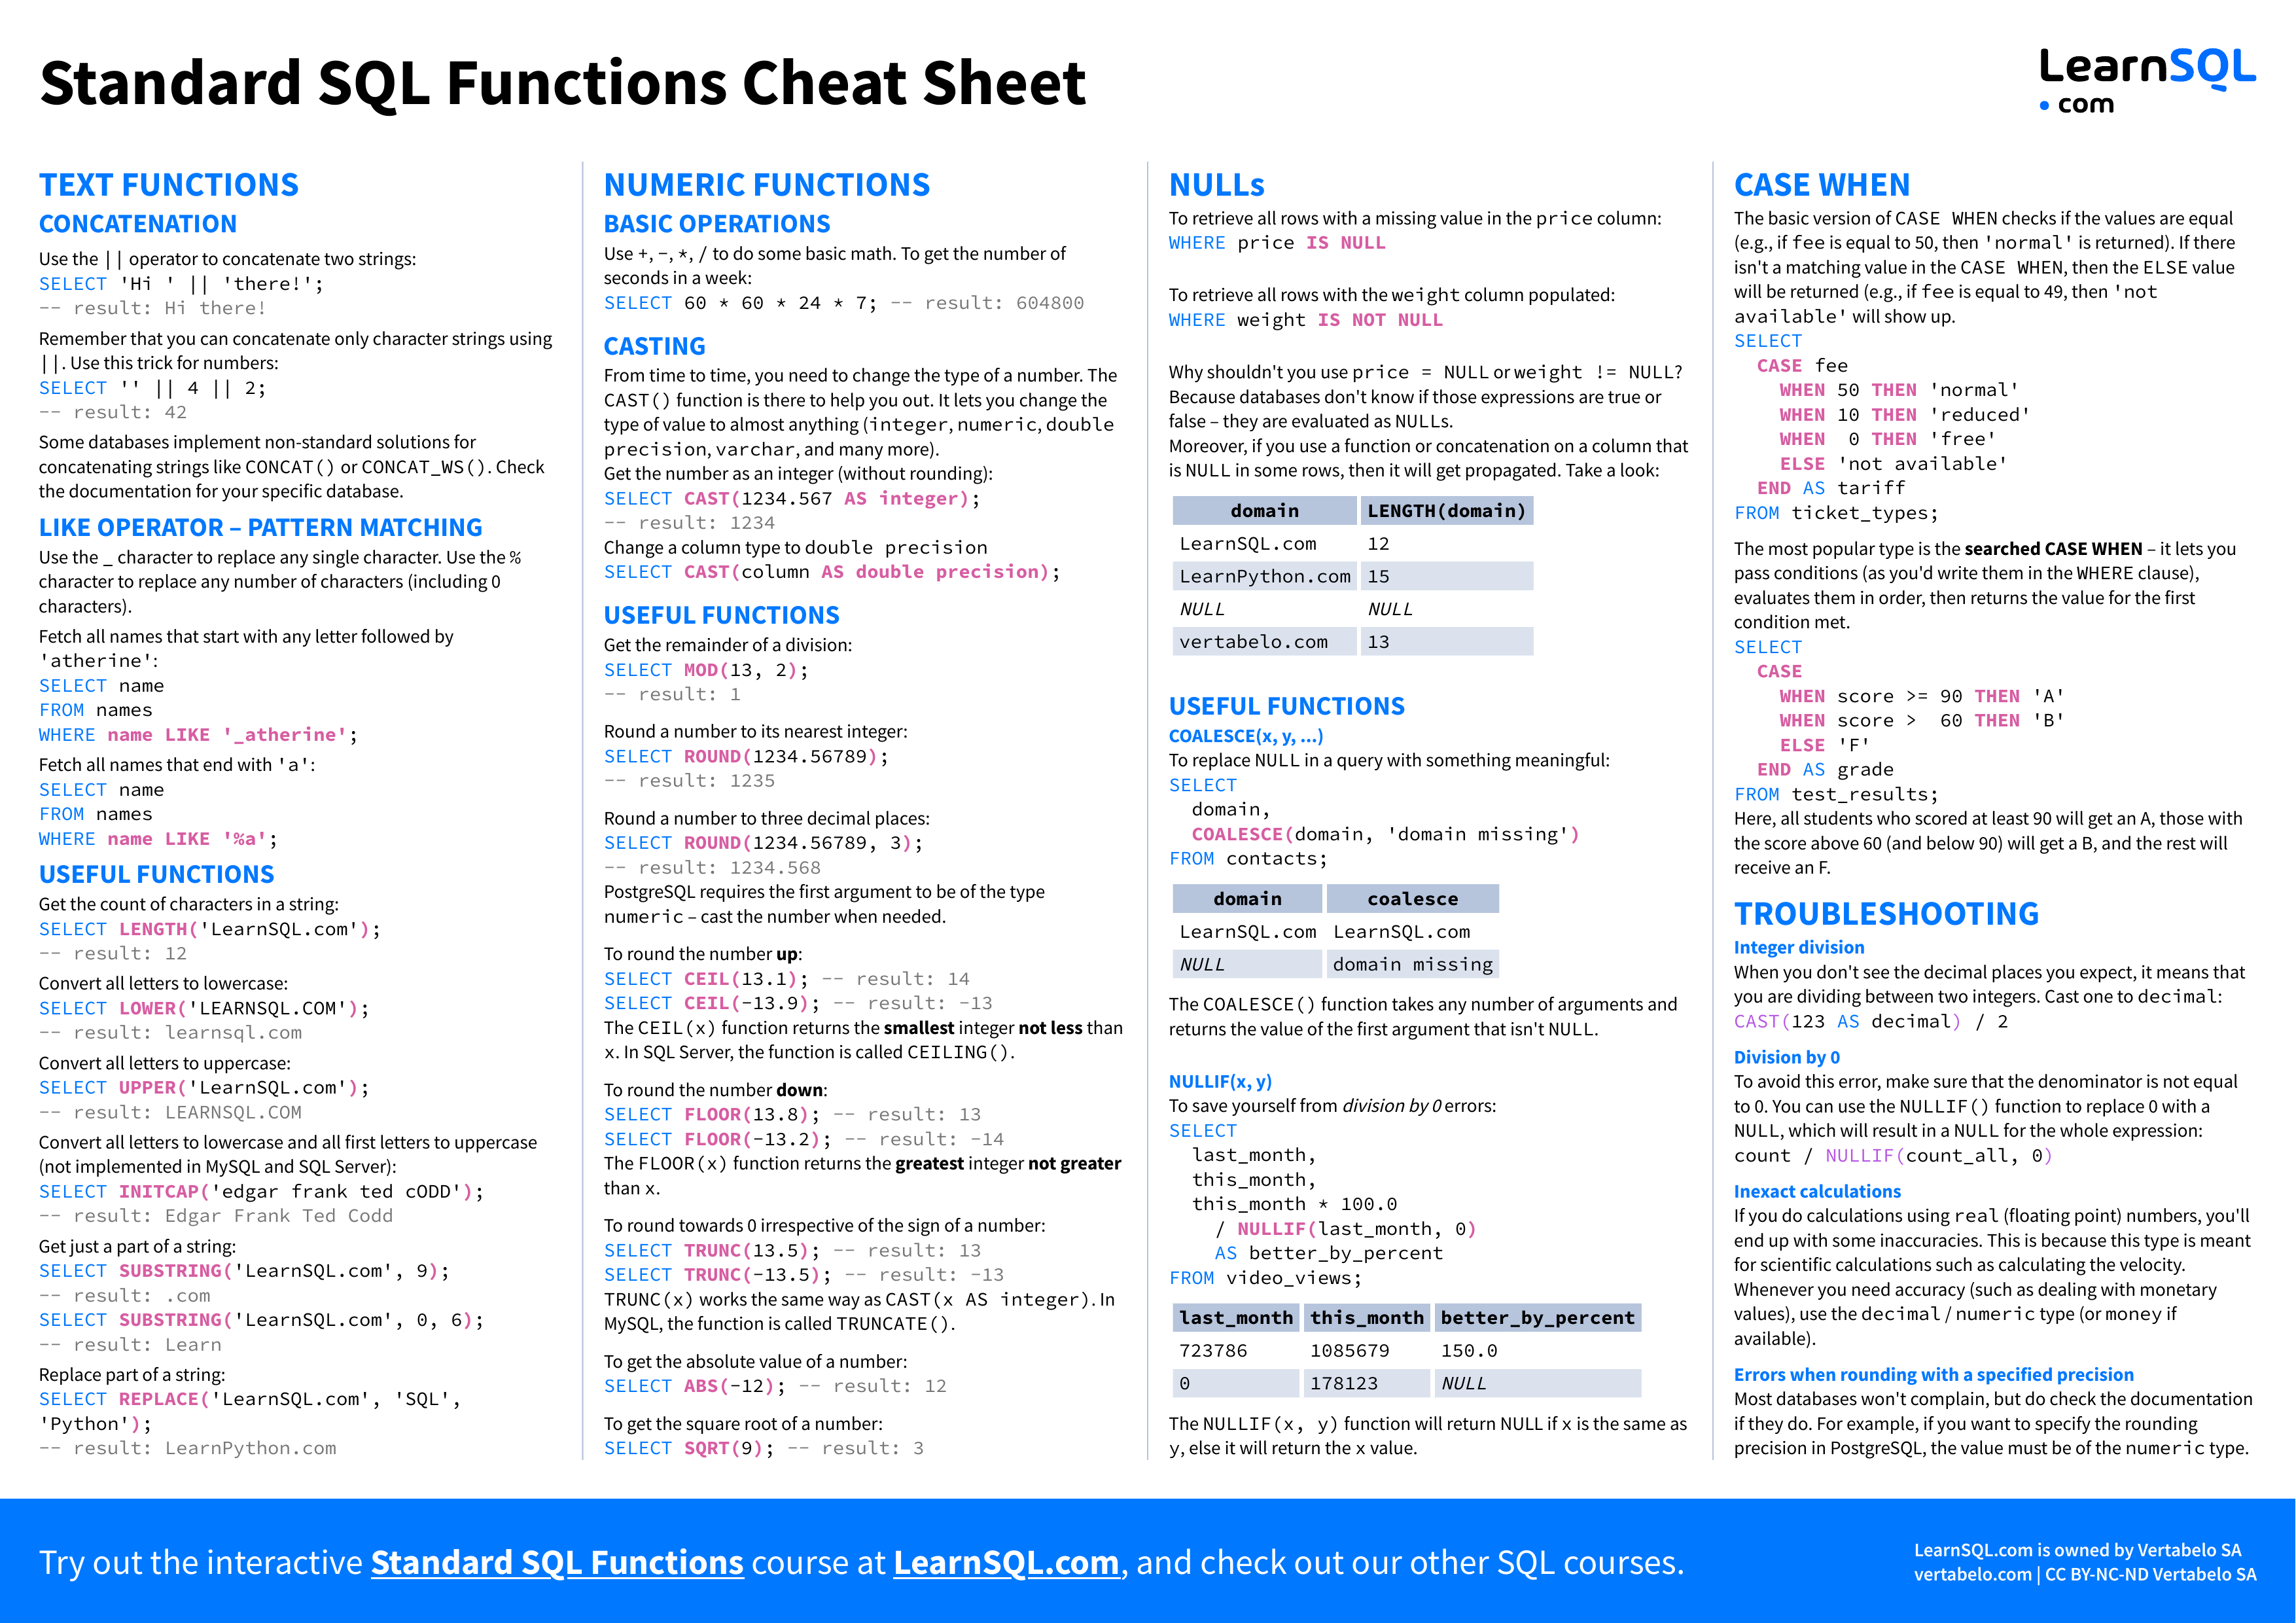
Functions

Slide 47
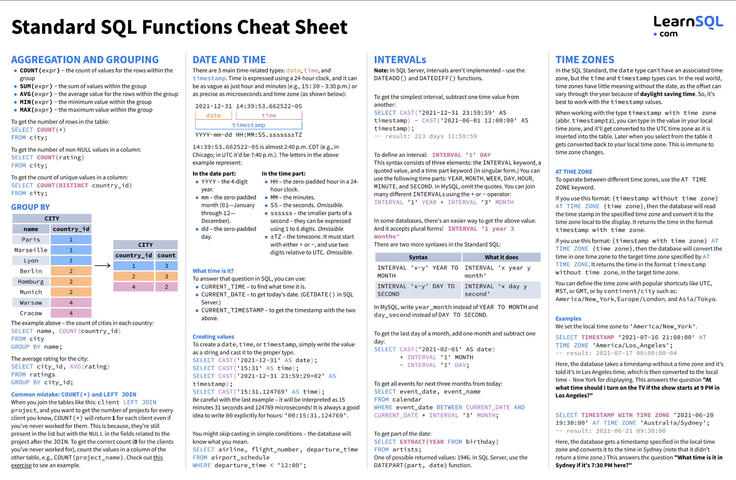
Functions

Slide 48
Functions
The are dozens if not hundreds of standard functions in SQL.
All DBMS implementations have product specific functions.
General rule:
If you have to do something, ask yourself
Am I the first one who ever had to do this?
If the answer is “No,” then ask Dr. Google/ChatGPT.
If the answer is Yes,” ask yourself, “Am I sure this is a good idea.”
The functions are useful and straightforward.
Some examples ➔ To the notebook we go, yo ho!

Slide 49
Views
49 | COMS W4111_002_2024_1: Lecture 5: ER, Relational, SQL (IV) © Donald F. Ferguson, 2024

Slide 50
Views
In some cases, it is not desirable for all users to see the entire logical model (that is, all the actual relations stored in the database.)
Consider a person who needs to know an instructors name and department, but not the salary. This person should see a relation described, in SQL, by select ID, name, dept_name from instructor
A view provides a mechanism to hide certain data from the view of certain users.
Any relation that is not of the conceptual model but is made visible to a user as a “virtual relation” is called a view.

Slide 51
View Definition
A view is defined using the create view statement which has the form
create view v as < query expression >
where <query expression> is any legal SQL expression. The view name is represented by v.
Once a view is defined, the view name can be used to refer to the virtual relation that the view generates.
View definition is not the same as creating a new relation by evaluating the query expression
Rather, a view definition causes the saving of an expression; the expression is substituted into queries using the view.

Slide 52
View Definition and Use
A view of instructors without their salary
create view faculty as select ID, name, dept_name from instructor
Find all instructors in the Biology department
select name from faculty where dept_name = 'Biology'
Create a view of department salary totals
create view departments_total_salary(dept_name, total_salary) as select dept_name, sum (salary) from instructor group by dept_name;

Slide 53
Views Defined Using Other Views
One view may be used in the expression defining another view
A view relation v₁ is said to depend directly on a view relation v₂ if v₂ is used in the expression defining v₁
A view relation v₁ is said to depend on view relation v₂ if either v₁ depends directly to v₂ or there is a path of dependencies from v₁ to v₂
A view relation v is said to be recursive if it depends on itself.

Slide 54
Views Defined Using Other Views
create view physics_fall_2017 as select course.course_id, sec_id, building, room_number from course, section where course.course_id = section.course_id and course.dept_name = 'Physics' and section.semester = 'Fall' and section.year = '2017’;
create view physics_fall_2017_watson as select course_id, room_number from physics_fall_2017 where building= 'Watson';

Slide 55
View Expansion
Expand the view :
create view physics_fall_2017_watson as select course_id, room_number from physics_fall_2017 where building= 'Watson'
To:
create view physics_fall_2017_watson as
select course_id, room_number
from (select course.course_id, building, room_number
from course, section
where course.course_id = section.course_id
and course.dept_name = 'Physics'
and section.semester = 'Fall'
and section.year = '2017')
where building= 'Watson';

Slide 56
View Expansion (Cont.)
A way to define the meaning of views defined in terms of other views.
Let view v₁ be defined by an expression e₁ that may itself contain uses of view relations.
View expansion of an expression repeats the following replacement step:
repeat Find any view relation v_{i} in e₁ Replace the view relation v_{i} by the expression defining v_{i} until no more view relations are present in e₁
As long as the view definitions are not recursive, this loop will terminate

Slide 57
Materialized Views
Certain database systems allow view relations to be physically stored.
Physical copy created when the view is defined.
Such views are called Materialized view:
If relations used in the query are updated, the materialized view result becomes out of date
Need to maintain the view, by updating the view whenever the underlying relations are updated.

Slide 58
Update of a View
Add a new tuple to faculty view which we defined earlier
insert into faculty
values ('30765', 'Green', 'Music');
This insertion must be represented by the insertion into the instructor relation
Must have a value for salary.
Two approaches
Reject the insert
Inset the tuple
('30765', 'Green', 'Music', null)
into the instructor relation

Slide 59
Some Updates Cannot be Translated Uniquely
create view instructor_info as select ID, name, building from instructor, department where instructor.dept_name= department.dept_name;
insert into instructor_info
values ('69987', 'White', 'Taylor');
Issues
Which department, if multiple departments in Taylor?
What if no department is in Taylor?

Slide 60
And Some Not at All
create view history_instructors as select * from instructor where dept_name= 'History';
What happens if we insert
('25566', 'Brown', 'Biology', 100000)
into history_instructors?

Slide 61
View Updates in SQL
Most SQL implementations allow updates only on simple views
The from clause has only one database relation.
The select clause contains only attribute names of the relation, and does not have any expressions, aggregates, or distinct specification.
Any attribute not listed in the select clause can be set to null
The query does not have a group by or having clause.

Slide 62
Integrity Constraints
62 | COMS W4111_002_2024_1: Lecture 5: ER, Relational, SQL (IV) © Donald F. Ferguson, 2024

Slide 63
Integrity Constraints
Integrity constraints guard against accidental damage to the database, by ensuring that authorized changes to the database do not result in a loss of data consistency.
A checking account must have a balance greater than $10,000.00
A salary of a bank employee must be at least $4.00 an hour
A customer must have a (non-null) phone number
DFF
Without integrity constraints in the database, maintaining data correctness requires:
Lots of users know what to do and do not make mistakes.
Dozens of programs correctly implement constraints in the code and stay up to date on changes.
Implementing the constraints as part of the schema eliminates many issues.

Slide 64
Constraints on a Single Relation
not null
primary key
unique
check (P), where P is a predicate

Slide 65
Not Null Constraints
not null
Declare name and budget to be not null
name varchar(20) not null budget numeric(12,2) not null

Slide 66
Unique Constraints
unique ( A₁, A₂, …, A_{m})
The unique specification states that the attributes A₁, A₂, …, A_{m} form a candidate key.
Candidate keys are permitted to be null (in contrast to primary keys).

Slide 67
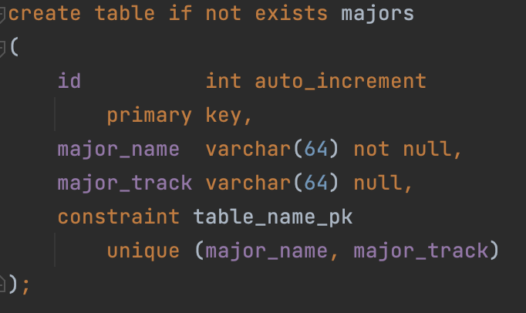
Simple Example
Consider a simple example of an entity class major:
major(id, name, track)
“id” is a uniquely generated ID
“name” is the major name, e.g. “Computer Science,” “Economics,” … …
“track” is a sub-track/specialty within the major, e.g. “Applications,” “AI/ML,” ...
“track” is optional
The combination of (name, track) is unique.
Note: In many DBMS, this automatically creates indices for keys/constraints.
Switch to Notebook.

Slide 68
The check clause
The check (P) clause specifies a predicate P that must be satisfied by every tuple in a relation.
Example: ensure that semester is one of fall, winter, spring or summer
create table section
(course_id varchar (8),
sec_id varchar (8),
semester varchar (6),
year numeric (4,0),
building varchar (15),
room_number varchar (7),
time slot id varchar (4),
primary key (course_id, sec_id, semester, year),
check (semester in ('Fall', 'Winter', 'Spring', 'Summer')))
DFF:
We could handle the semester check with an enum.
Switch to notebook for a slightly different example.

Slide 69
Referential Integrity
Ensures that a value that appears in one relation for a given set of attributes also appears for a certain set of attributes in another relation.
Example: If “Biology” is a department name appearing in one of the tuples in the instructor relation, then there exists a tuple in the department relation for “Biology”.
Let A be a set of attributes. Let R and S be two relations that contain attributes A and where A is the primary key of S. A is said to be a foreign key of R if for any values of A appearing in R these values also appear in S.

Slide 70
Referential Integrity (Cont.)
Foreign keys can be specified as part of the SQL create table statement
foreign key (dept_name) references department
By default, a foreign key references the primary-key attributes of the referenced table.
SQL allows a list of attributes of the referenced relation to be specified explicitly.
foreign key (dept_name) references department (dept_name)

Slide 71
Cascading Actions in Referential Integrity
When a referential-integrity constraint is violated, the normal procedure is to reject the action that caused the violation.
An alternative, in case of delete or update is to cascade
create table course ( (… dept_name varchar(20), foreign key (dept_name) references department on delete cascade on update cascade, . . .)
Instead of cascade we can use :
set null,
set default
DFF:
I do not like using cascade. I think making changes should be explicit.
Other people disagree.
You will get some simple practice on HW or exams.

Slide 72
Indexes Review, Concepts, Examples
72 | COMS W4111_002_2024_1: Lecture 5: ER, Relational, SQL (IV) © Donald F. Ferguson, 2024

Slide 73
Index Creation
Many queries reference only a small proportion of the records in a table.
It is inefficient for the system to read every record to find a record with particular value
An index on an attribute of a relation is a data structure that allows the database system to find those tuples in the relation that have a specified value for that attribute efficiently, without scanning through all the tuples of the relation.
We create an index with the create index command
create index <name> on <relation-name> (attribute);

Slide 74
Index Creation Example
create table student (ID varchar (5), name varchar (20) not null, dept_name varchar (20), tot_cred numeric (3,0) default 0, primary key (ID))
create index studentID_index on student(ID)
The query:
select * from student where ID = '12345'
can be executed by using the index to find the required record, without looking at all records of student
DFF:
An index on (column1, column2, column3)
Is also an index on (column1) and (column1, column2)
But not (column2), (column3), (column2, column3).
We will see “why” later in the semester.

Slide 75
REST
75 | COMS W4111_002_2023_3: Lecture 5: ER, Relational, SQL (IV), Applications © Donald F. Ferguson, 2023

Slide 76
Data Modeling Concepts and REST
Almost any data model has the same core concepts:
Types and instances:
Entity Type: A definition of a type of thing with properties and relationships.
Entity Instance: A specific instantiation of the Entity Type
Entity Set Instance: An Entity Type that:
Has properties and relationships like any entity, but ...
Has at least one special relationship – contains.
Operations, minimally CRUD, that manipulate entity types and instances:
Create
Retrieve
Update
Delete
Reference/Identify/... ...

Slide 77
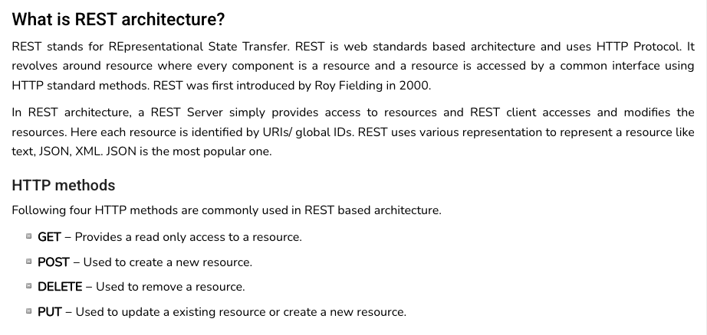
REST (https://www.tutorialspoint.com/restful/restful_introduction.htm)

Slide 78
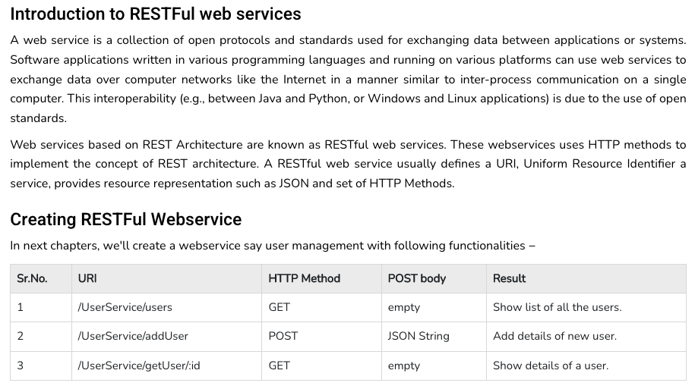
REST (https://www.tutorialspoint.com/restful/restful_introduction.htm)

Slide 79
REST and Resources

Slide 80
URLs

Slide 81
jdbc:mysql://columbia-examples.ckkqqktwkcji.us-east-1.rds.amazonaws.com:3306

Slide 82
Simplistic, Conceptual Mapping (Examples)
REST Method | Resource Path | Relational Operation | DB Resource
DELETE | /people | DROP TABLE | people table
POST | /people | INSERT INTO PEOPLE (...) VALUES(...) | people table people row
GET | /people/21 | SHOW KEYS FROM people ...; SELECT * FROM people WHERE playerID= 21 | people row
GET | /people/21/batting | SELECT batting.* FROM people JOIN batting USING(playerID) WHERE playerID=21
GET | /people/21/batting/2004_1 | SELECT batting.* FROM people JOIN batting USING(playerID) WHERE playerID=21 AND yearID=2004 AND stint=1

Slide 83
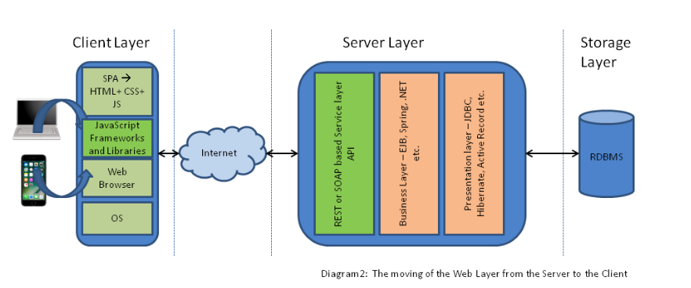
Application Architecture

Slide 84
Walkthrough
Simple web application template.
Calling some cloud APIs.

Slide 85
Sample Projects
85 | COMS W4111_002_2024_1: Lecture 5: ER, Relational, SQL (IV) © Donald F. Ferguson, 2024

Slide 86
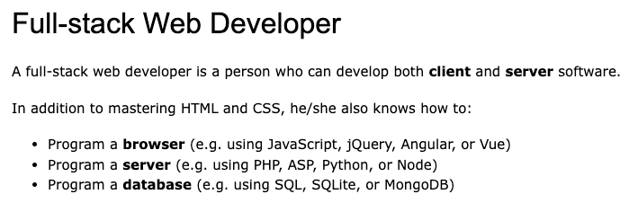
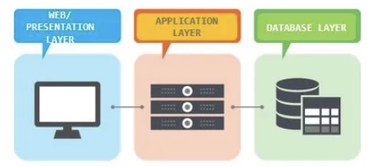
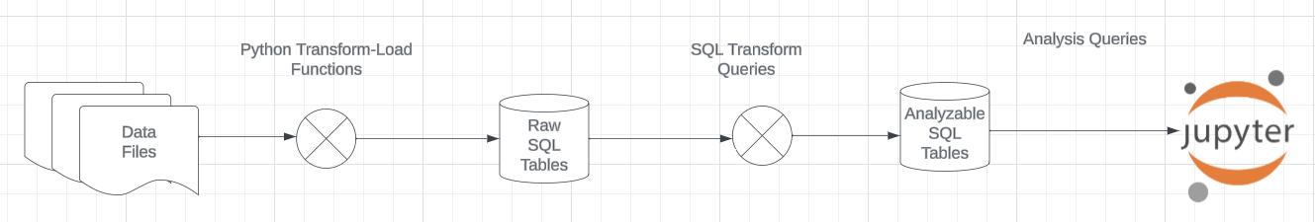
Projects
The programming track will implement a simple, full stack web application.
The non-programming track will implement a data engineering and visualization process in a Jupyter notebook.

Slide 87
Game of Thrones
Bottom-Up Data Mapping:
“Nouns” usually map to Entity/Entity Set.
Nouns inside other nouns often map to:
Attribute
Relationship
Verbs often map to relationships.
Adjectives usually map to properties.
We will start with a subset of the information:
Game of Thrones:
Episodes
Characters
IMDB:
names_basics
title_basics
Entities Sets
Character
Season
Episode
Scene
Location, Sublocation
... ...
Relationships
Character – Scene
Character – Character (e.g. KilledBy)
Season – IMDB Title
Character – IMDB Name
... ...

Slide 88
Game of Thrones
Bottom-Up Data Mapping:
“Nouns” usually map to Entity/Entity Set.
Nouns inside other nouns often map to:
Attribute
Relationship
Verbs often map to relationships.
Adjectives usually map to properties.
We will start with a subset of the information:
Game of Thrones:
Episodes
Characters
IMDB:
names_basics
title_basics
Entities Sets
Character
Season
Episode
Scene
Location, Sublocation
... ...
Relationships
Character – Scene
Character – Character (e.g. KilledBy)
Season – IMDB Title
Character – IMDB Name
... ...
IMDB: https://developer.imdb.com/non-commercial-datasets/
Do not download.
Despite being “tiny” compared to the reall world.
The datasets are too big for most laptops.
Game of Thrones: https://github.com/jeffreylancaster/game-of-thrones

Slide 89
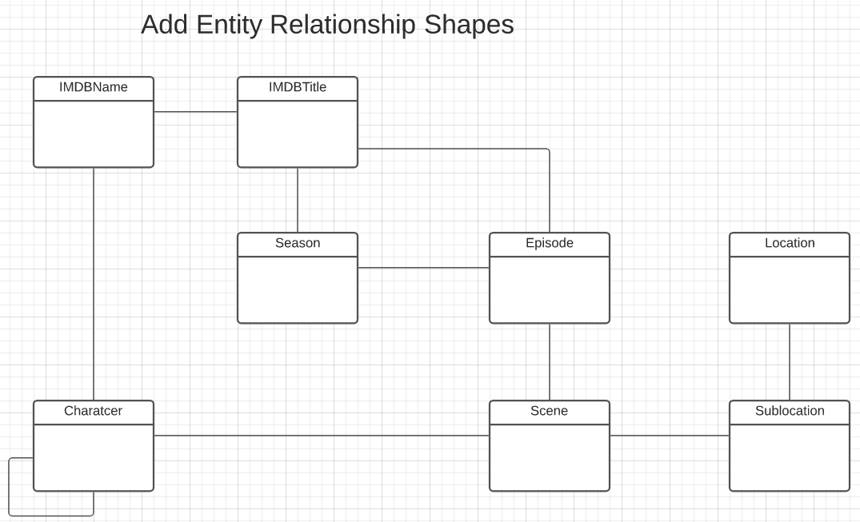
Game of Thrones – Conceptual Model
Add shapes in Lucidchart ...
With a little
Data exploration
Common sense
Judgment/experience
I came to this conceptual model.
Attributes unspecified
Relationship required/cardinality unspecified.
A little more exploration is needed.

Slide 90
Sample Projects
Walkthrough of Web Apps:
/Users/donaldferguson/Dropbox/000/000-A-Current-Examples/W4111-FastAPI-IMDB-Solution
/Users/donaldferguson/Dropbox/000/000-A-Current-Examples/current-dashboard
Data Engineering:
/Users/donaldferguson/Dropbox/000/000-Columbia/2024-Spring/W4111-Intro-to-Databases-Spring-2024/Lectures/s-2024-Lecture-3/More-Data-Engineering.ipynb
And others.

